Slide 1
Prof. Magdy M. Doss

Slide 2
References
M.A. Mazidi and J.G. Mazidi, The 80X86 and Compatible Computers Assembly Language, Prentice Hall 2003
Peter Abel, IBM PC Assembly Language and Programming, Prentice Hall 2001

Slide 3
Contents
Week | Subjects
1 | Review of numbering and coding systems Review of the computer organization Brief history of the 80X86 family MOV & ADD instructions Program segments Addressing modes
2 | Directives Assembling, linking and running a program Sample programs Control transfer instructions
3 | Data types and data definition Simplified segment definition EXE vs. COM files

Slide 4
Some Important Terminology
Nibble = 4 bits
Byte = 8 bits = 2 Nibbles
Word = 16 bits = 2 Bytes
Double Word = 32 bits = 2 Words
Quad Word = 64 bits = 4 Words
Paragraph = 128 bits = 16 Bytes
K. Byte = 2¹⁰ Bytes = 1024 Bytes
M. Byte = 2²⁰ Bytes = 1,048,576 Bytes

Slide 5
Basic Parts of a Computer
CPU
Address
Memory
Control
Data
I/O

Slide 6
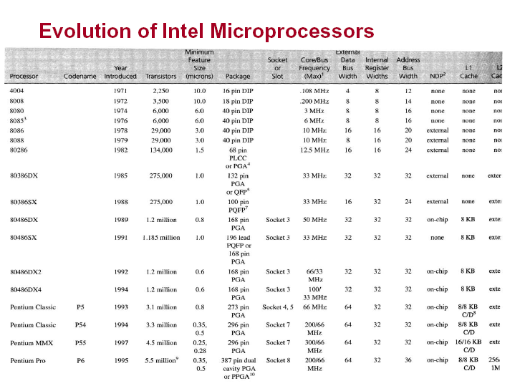

Slide 7
Intel 80x86 Evolution
Internal
Data
Bus
External
Data
Bus
Transistor
Count
Clock
Speed
Address
Bus
µPro_{s}
Year
4004
8080
8085
8086
8088
80286
80386DX
80486DX
Pentium
Pentium Pro
Pentium II
Pentium III
1971
1974
1976
1978
1979
1982
1985
1989
1993
1995
1997
1999
2 250
6 000
6 500
29 000
29 000
134 000
275 000
1.2 million
3.1 million
5.5 million
7.5 million
28.1 million
0.108 MHz
2 MHz
3-8 MHz
4.77 MHz
4.77 MHz
8 MHz
16 MHz
25 MHz
60 MHz
150 MHz
233 MHz
450 MHz
4-bit
8-bit
8-bit
16-bit
16-bit
16-bit
32-bit
32-bit
32-bit
32-bit
32-bit
32-bit
4-bit
8-bit
8-bit
16-bit
8-bit
16-bit
32-bit
32-bit
64-bit
64-bit
--
--
--
16-bit
16-bit
20-bit
20-bit
24-bit
32-bit
32-bit
32-bit
36-bit
--
--

Slide 8
8086/8088 Architecture
External data bus
16/8 pins
Segment
Registers
Control Flags
General
Registers
Control
16 pins
IP
Address
20 pins
Address Generation
And Bus Control
Internal data bus
+5 V
Operands
GND
GND
Arithmetic
Logic Unit
Instruction
Queue
Clock
Execution Unit
Bus Interface Unit

Slide 9
Pipelining
FETCH 1 | EXEC 1 | FETCH 2 | EXEC 2
FETCH 1 | EXEC 1
 | FETCH 2 | EXEC 2
 |  | FETCH 3 | EXEC 3

Slide 10
8086/8088 Programming Model
General Purpose Registers
Segment Registers
Accumulator
AX
AH
AL
Code Segment
CS
Base
BX
BH
BL
Data Segment
DS
Count
CX
CH
CL
Extra Segment
ES
Data
DX
DH
DL
Stack Segment
SS
Pointer Registers
Flag Register
Stack Pointer
SP
Status and
Control Flags
Base Pointer
Flags_{H}
Flags_{L}
BP
Index Registers
Instruction Register
Source Index
SI
Instruction
Pointer
IP
Destination Index
DI
All registers are 16 bits (2 bytes) long.

Slide 11
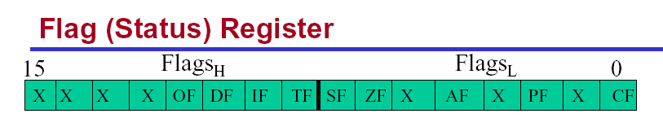
CF = carry flag
PF = parity flag
AF = auxiliary flag
ZF = zero flag
SF = sign flag
TF = trap flag
IF = interrupt flag
DF = direction flag
OF = overflow flag

Slide 12
Memory Map for IBM PC
The 640k RAM: Conventional memory
The DOS OS first allocate the available RAM for its own use and then let the rest be used by applications.
The 64KB (F0000H-FFFFFH) ROM are used by the BIOS. BIOS contains programs that used to RAM and other components connected to the CPU. And programs that allow DOS to communicate with peripheral devices.
It is only after testing and setting up the peripherals that the BIOS will load DOS from disk into RAM and hand over control of the PC to DOS
00000H
RAM
640K
9FFFFH
A0000H
Video Display RAM
128K
8FFFFH
C0000H
ROM
256K
FFFFFH

Slide 13
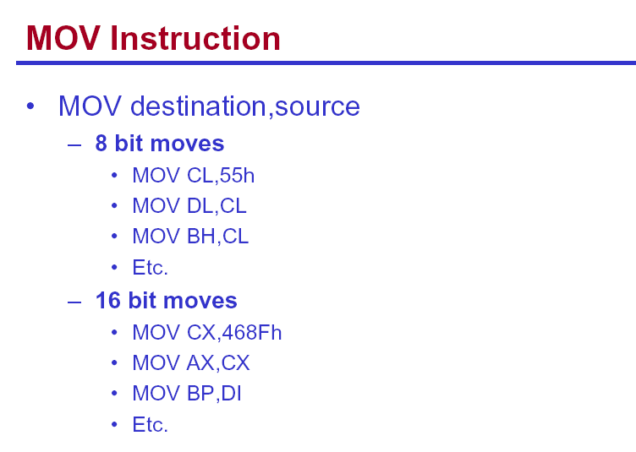

Slide 14
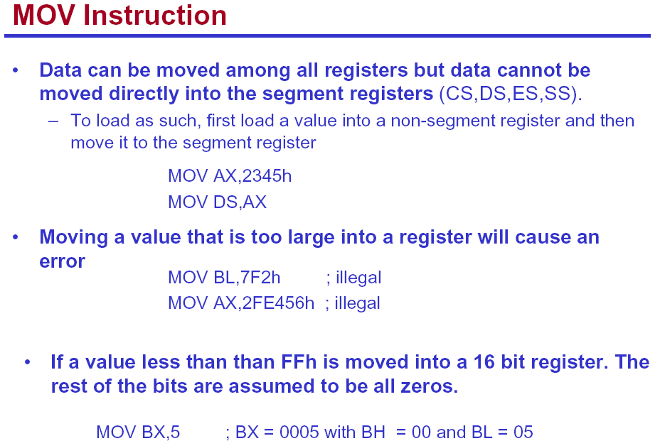

Slide 15
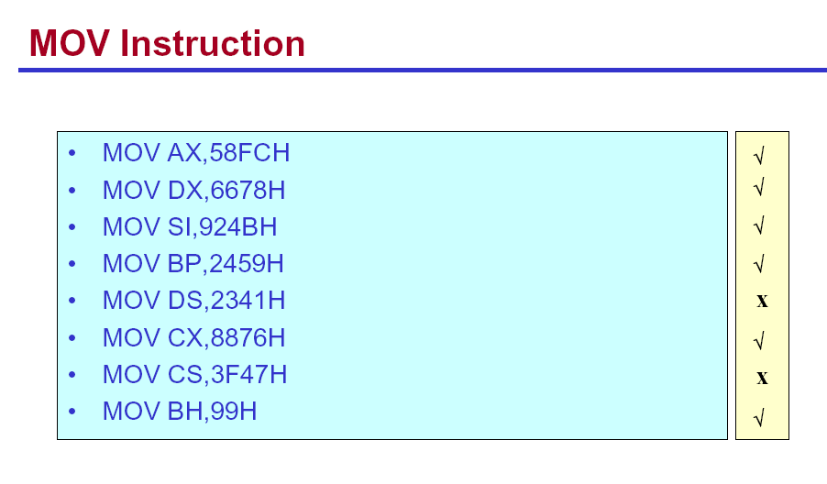

Slide 16
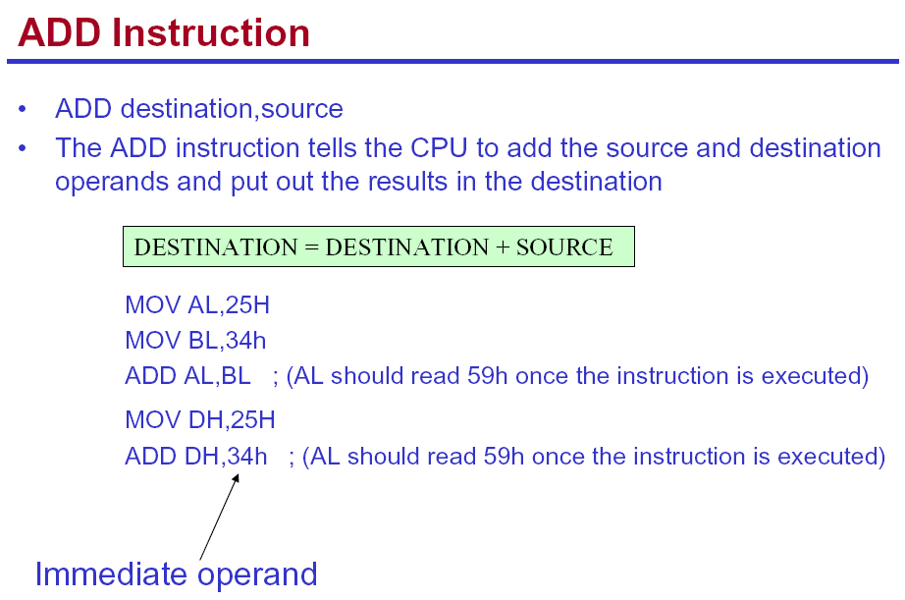

Slide 17
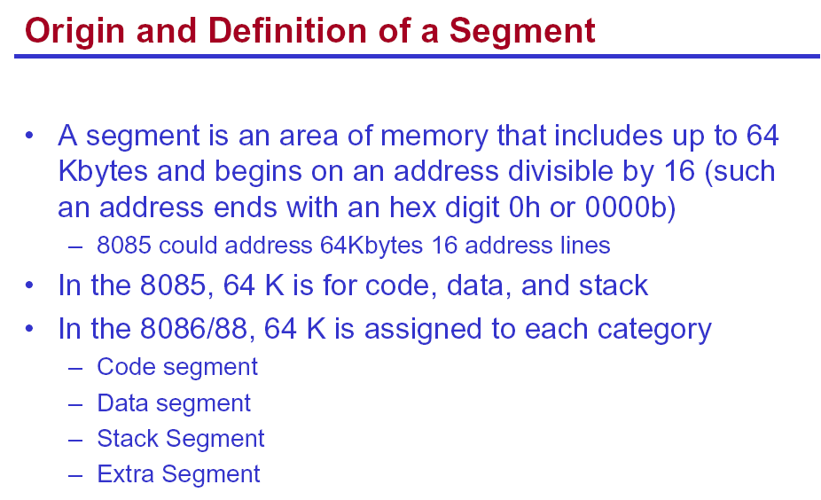

Slide 18
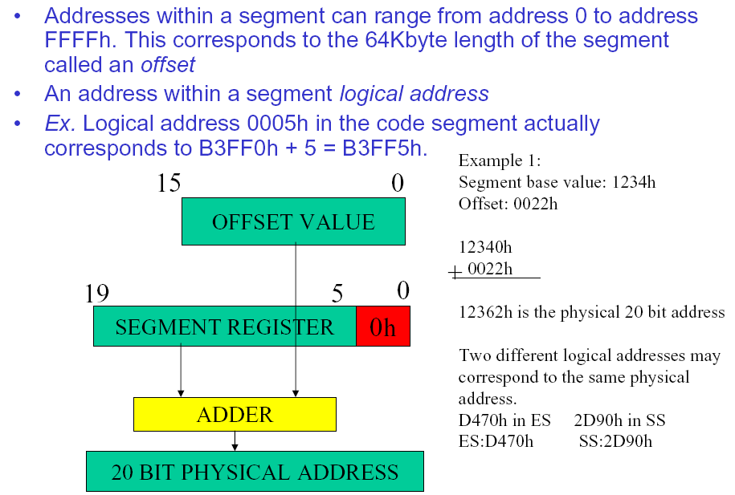

Slide 19
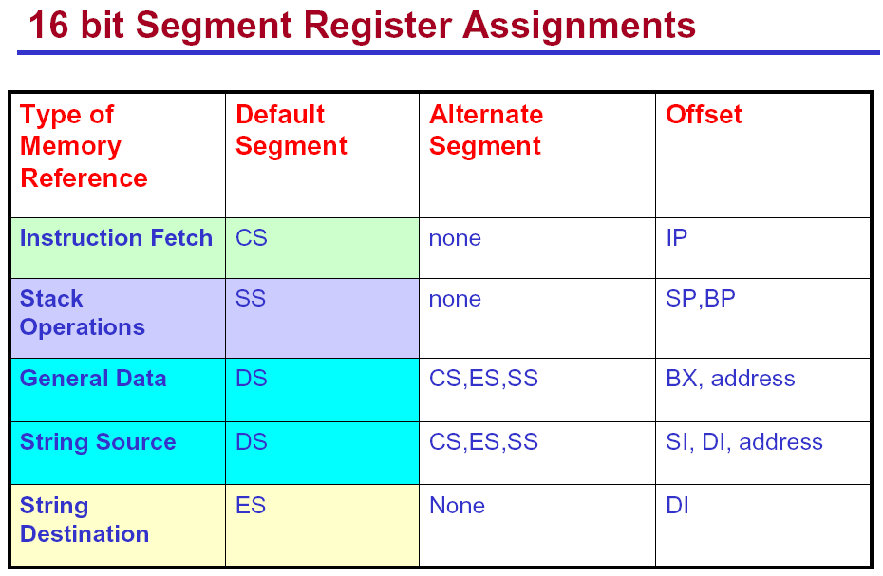

Slide 20
Memory Mapping
Code: F0000H to FFFFFH
Data: 00000H to 0FFFFH
Extra: B3000H to C2FFFH
Stack: C0000H to CFFFFH
FFFFFH
Code
F0000H
CFFFFH
Stack
C2FFFH
C0000H
Extra
B3000H
The Extra and Stack segments
partially overlap. Data in this
region of memory can be accessed
in either segment.
CAREFUL!!
0FFFFH
Data
00000H

Slide 21
Little Endian, Big Endian
All memory in 80x86 systems are byte-addressable.
Store 12H, 34H, 56H, and 78H in locations 10000H to 10003H.
Store 1234H and 5678H in locations 10000H to 10003H.
10003H
10003H
10002H
10002H
10001H
10001H
10000H
10000H
Big Endian
Little Endian

Slide 22
Little Endian, Big Endian
All memory in 80x86 systems are byte-addressable.
Store 12H, 34H, 56H, and 78H in locations 10000H to 10003H.
10003H
78H
10002H
56H
10001H
34H
10000H
12H

Slide 23
Little Endian, Big Endian
Store 1234H and 5678H in locations 10000H to 10003H.
10003H
78H
10003H
56H
10002H
56H
10002H
78H
10001H
34H
10001H
12H
10000H
12H
10000H
34H
Big Endian
Little Endian

Slide 24
STACK Operation Example (1)
Assume that SP=1360, AX=34FC, DI=4B6D and DX=9F53, show
the contents of the stack and the registers as each of the following
instructions is executed:
PUSH AX
PUSH DI
PUSH DX
SS:135A
53H
SS:135B
9FH
SS:135C
6DH
6DH
SS:135D
4BH
4BH
SS:135E
FCH
FCH
FCH
SS:135F
34H
34H
34H
SS:1360
Start
SP=1360
After PUSH AX
SP=135E
After PUSH DI
SP=135C
After PUSH DX
SP=135A

Slide 25
STACK Operation Example (2)
Assume that SP=1360, AX=34FC, DI=4B6D and DX=9F53, show
the contents of the stack and the registers as each of the following
instructions is executed:
POP CX
POP DI
POP BX
SS:135A
53H
SS:135B
9FH
SS:135C
6DH
6DH
SS:135D
4BH
4BH
SS:135E
FCH
FCH
FCH
SS:135F
34H
34H
34H
SS:1360
Start
SP=135A
After POP CX
SP=135C, CX=9F53
After POP DI
SP=135E, DI=4B6D
After POP BX
SP=1360, BX=34FC

Slide 26
80x86 Addressing Mode
The ways the CPU access operands.
The number of addressing modes is determined when the uP is designed and can’t be changed.
Seven distinct addressing mode for 80x86
  1. Register addressing mode
    Memory is not accessed.
    Very fast to execute.
    E.g., MOV BX, DX
    The source and destination must match in size

Slide 27
80x86 Addressing Mode
Seven distinct addressing mode for 80x86
  2. Immediate addressing mode
    The source operand is a constant
    Also executes quickly as immediate number already in CPU
    This mode is used to load information to registers (which?)
    E.g., MOV AX, 0F2B5H,
  3. Direct addressing mode
    Data is in some memory locations.
    The address of data in memory comes immediately after the instruction.
    E.g., MOV CX, [2000H]
  Difference: Immediate and Direct addressing mode
    Immediate AM: Operand itself is provided with the instruction
    Direct AM: The (Offset) address of the operand is provided.

Slide 28
80x86 Addressing Mode
Seven distinct addressing mode for 80x86
  4. Register indirect addressing mode
    The (offset) address of the operand is held by a register, also known as pointers
    Registers used for this purpose are SI, DI, and BX,
    Default segment register is DS to product the 20-bit P.A.
    E.g., MOV CL, [BX]
    If two bytes are required to be retrieved / stored, two consequent address will be used.
    E.g., MOV WORD PTR [SI], AX
    DS:[SI] ← AL, DS:[SI+1] ← AH

Slide 29
80x86 Addressing Mode
Seven distinct addressing mode for 80x86
  5. Based relative addressing mode
    In this mode, base registers (BX, BP), as well as a displacement value, are used to calculate the effective address
    The effective address is the calculated offset for the data and is an unsigned 16-bit value. It is then added to the appropriate segment register x 16 to generate the physical address
    The default segments for the PA calculation are
      DS for BX SS for BP
    E.g., MOV CX, [BX] + 10; PA = DS : BX + 10
    same as MOV CX, [BX+10]
    MOV AL, [BP] + 5; PA = SS : BP + 5

Slide 30
80x86 Addressing Mode
Seven distinct addressing mode for 80x86
  6. Indexed Relative Addressing Mode
    Same as the Based Relative AM, except that index registers SI and DI hold the offset address
    E.g., MOV DX, [SI] + 5 ; PA = DS : SI + 5
    MOV CL, [DI] + 20 ; PA = DS : DI + 20
  7. Based Indexed Addressing Mode
    Combine the based and indexed AM, one base register and one index register are used.
    E.g., MOV CL, [BX][DI]+5 ;PA = DS(←) + BX + DI + 5
    MOV AH, [BP+SI+10] ;PA = SS(←) + BP + SI +10

Slide 31
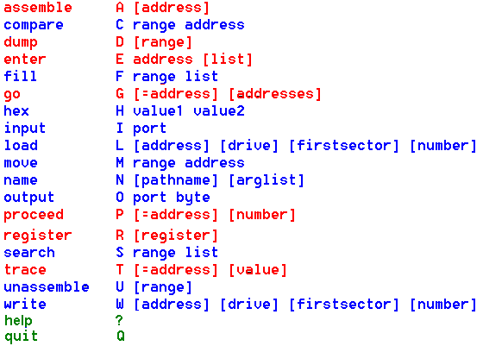
Debug Commands

Slide 32
Ex.: Examining ROM BIOS
D FE00:00 Checking copyright notice and serial number
D FFFF:05 Checking ROM BIOS Date

